Slide 1
Chapter 16 Least Squares Regression
By
Hyung Jae (Chris) Chang
Troy University

Slide 2

Introduction
From a given data points (x, y), we want to find an estimation function $\hat{y}(x)$.
$\hat{y}\left(x\right)$ can be a function of several variables but assuming only one in this section
$\hat{y}\left(x\right)$: linear combination of basis functions, f_{i}(x)
$α_{i}$: parameters of the estimation function
Each basis function must be linearly independent
$$\hat{y}\left(x\right)=\sum_{i=1}^{n}{α_{i}f_{i}(x)}$$
Goal (least squares regression): Find parameters of the estimation function that minimize the total squared error
$E=\sum_{i=1}^{m}{{(\hat{y}−y)}^{2}}$ where $(\hat{y}−y)$ is individual errors or residuals denoted as e_{i}
If e is the vector containing all the individual errors, then we want to minimize E= ${\left\|e\right\|}_{2}^{2}$, which is L₂ norm.

Slide 3
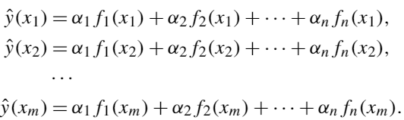



Least Squares Regression Derivation (Linear Algebra)
Estimation of data at each data point xi:
: a column vector such that the ith element of X contains the value of the ith x-data point, x_{i}.
$\hat{Y}$: a column vector with elements,
$β$: a column vector such that $β_{i}=α_{i}$
F_{i}(x): a function that returns a column vector of f_{i}(x) computed on every element of x
A: an m x n matrix such that the ith column of A is F_{i}(x).
Then $\hat{Y}=Aβ$

Slide 4
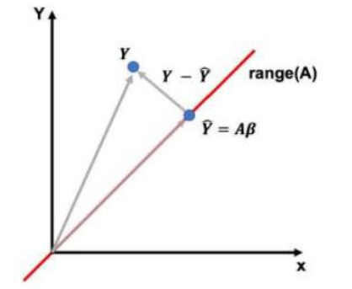

Least Squares Regression Derivation (Linear Algebra) (cont.)
If Y is a column vector such that Y_{i} = y_{i}, the total squared error is given by E =${\left\|\hat{Y}−Y\right\|}_{2}^{2}$ .
Verification
By substituting the definition of the L₂ norm which is the measure of distance.
Make E as small as possible → $\hat{Y}$ and $Y$ to be as close as possible
Note: in general, Y will not be in the range of A and there for E > 0.
Illustration of the L2 projection of Y on the range of A
* This is not a plot of the data points (x_{i}, y_{i})

Slide 5


Least Squares Regression Derivation (Linear Algebra) (cont.)
Observation: we want a vector$Y−\hat{Y}$ which is perpendicular to the vector $\hat{Y}$.
Two vectors are perpendicular (or orthogonal) → when their dot-product is 0. (cos($π$/2))
Dot-product between two vectors, v and w, can be written as
dot(v, w) = v^{T}w = |v||w| cos($θ$)
$\hat{Y}$ and $\hat{Y}−Y$ are perpendicular → dot($\hat{Y}$,$Y−\hat{Y}$) = 0, therefore $\hat{Y}$^{T}($Y−\hat{Y}$) = 0 which is equivalent to ${(Aβ)}^{T}\left(Y−Aβ\right)=0$.
By distributive properties of vector multiplication, we can obtain $β^{T}A^{T}Y−β^{T}A^{T}Aβ=β^{T}$($A^{T}Y−A^{T}Aβ$) = 0; $β$=0 for trivial solution so we use $A^{T}Y−A^{T}Aβ$ = 0
Solving for $β$ gives the least squares regression formula:

Slide 6
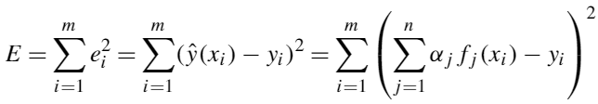

Least Squares Regression Derivation (Multivariate Calculus)
Recall: the total error for m data points and n basis function
which are n-dimensional paraboloid in $α_{k}$
From calculus, the minimum of a paraboloid is where all the partial derivatives equal to zero.

Slide 7
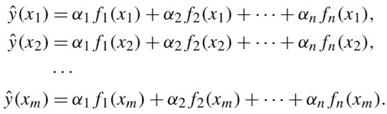
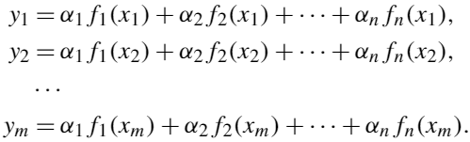


Least Squares Regression in Python
Recall the enumeration of the estimation of the data at each data point x_{i}.
If the data were perfect, we get the following system of equations:
A is defined as previously →
Since the data is not perfect, we use the least square regression to obtain a solution,

Slide 8
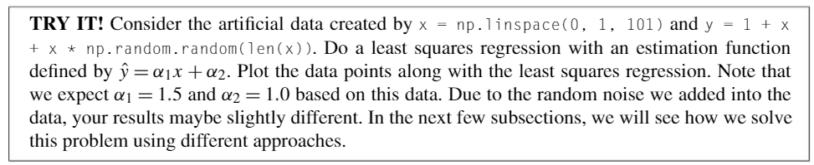
Example

Slide 9
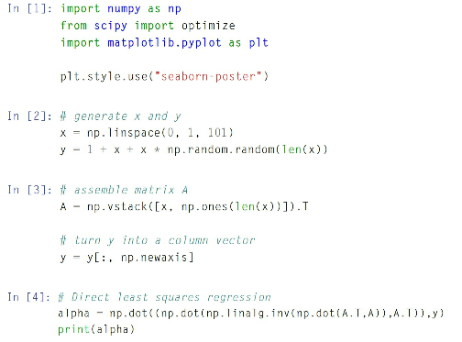
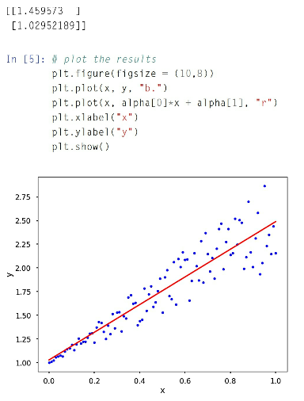

Least Squares Regression in Python (Using Direct Inverse Method)
$β$ = $({A^{T}A)}^{−1}A^{T}Y$

Slide 10
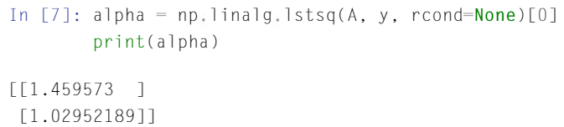
Least Squares Regression in Python (Using numpy.linalg.lstsq)
NumPy has already implemented the least squares methods.

Slide 11
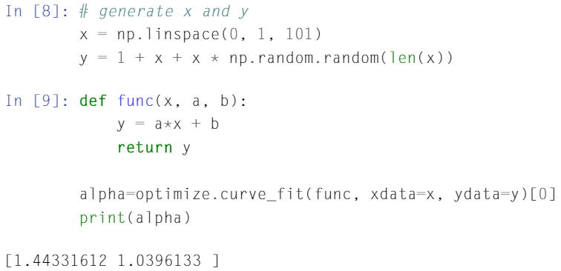
Least Squares Regression in Python (Using Optimize.curve_fit)
From SciPy library, we can use optimize.curve_fit function.
We do not need to turn y into a column vector.

Slide 12
Least Squares Regression for Nonlinear Functions
A least squares regression requires that the estimation function be a linear combination of basis functions.
There are some functions that can’t be put in this form, but where a least squares regression is still appropriate.
How?
By taking advantages of the properties of logarithms and transform the nonlinear function into a linear function.
By using curve_fit function from Scipy to estimate directly the parameters for the nonlinear function using least square.

Slide 13

Using Log Tricks for Exponential Functions
Assume that we have a function $\hat{y}\left(x\right)=αe^{βx}$ and data x and y → perform the Least Squares Regression to find $α$ and $β$.
Take log on both sides → $log\left(\hat{y}\left(x\right)\right)=\log{α}+βx$
If $\tilde{y}(x)=log\left(\hat{y}\left(x\right)\right)$ and $\tilde{α}=log α$, $\tilde{y}(x)=\tilde{α}+βx$ which is a linear form for which we can perform a least squares regression to find $\tilde{y}$(x), $\tilde{α}$ and $β$.
Then, we can recover $α$ by using $α=e^{\tilde{α}}$.

Slide 14
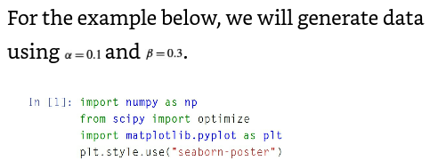
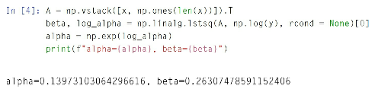
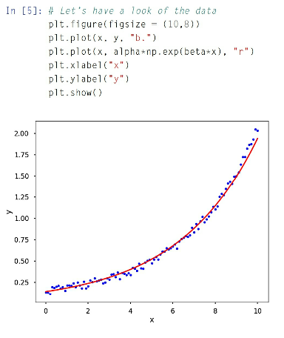
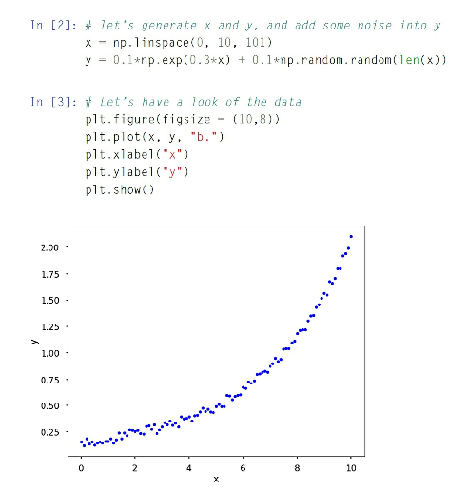
Using Log Tricks for Exponential Functions

Slide 15

Using Log Tricks for Power Functions
Function $\hat{y}\left(x\right)=bx^{m}$ and data for x and y.
By taking log on both side, we get $log\left(\hat{y}\left(x\right)\right)=m\log{x}+\log{b}$ which is a linear form.
And we solve this as a linear regression.

Slide 16
Using Polynomial Regression
Use polynomial and least squares to fit a nonlinear function.
Polynomials:
where a_{n}, a_{n-1}, … a₂, a₁ are the real number coefficients
and n (a non-negative integer) is the order or degree of the
polynomial.
In Python, numpy.polyfit is used to obtain the coefficients of different order polynomials with the least squares.
With the coefficients, numpy.polyval is used to obtain the specific values

Slide 17
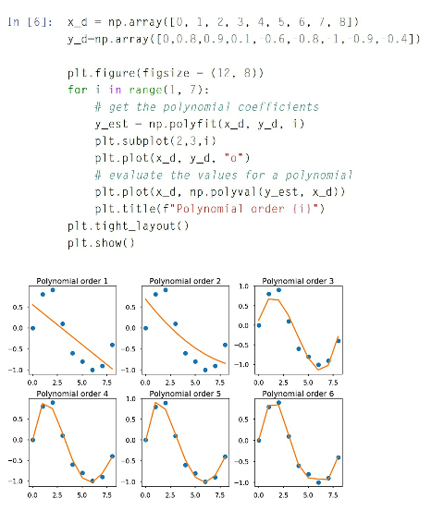
Using Polynomial Regression (cont.)

Slide 18
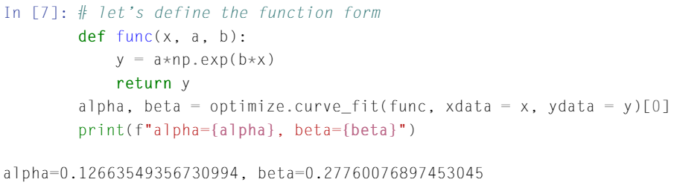
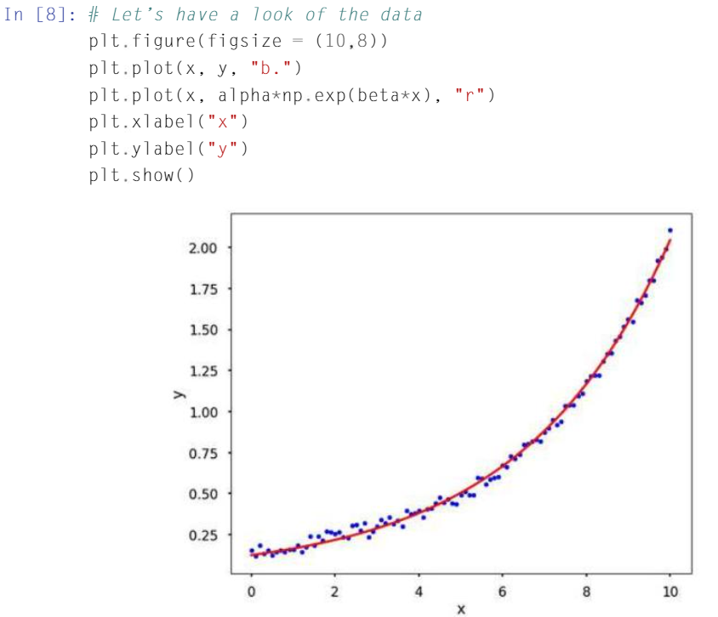
Using OPTIMIZE.CURVE_FIT from SCIPY

